Slide 1


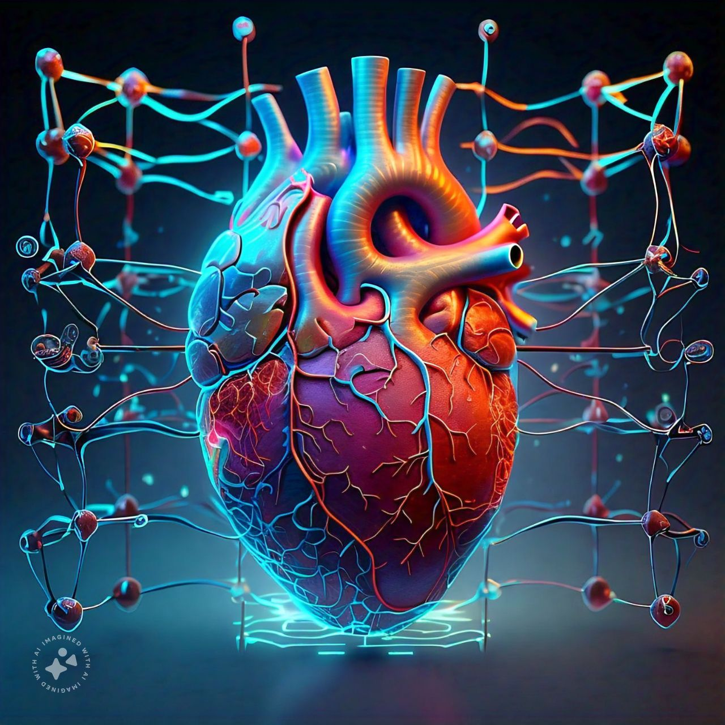
Visvesvaraya Technological​ University, Belagavi​
RURAL ENGINEERING COLLEGE HULKOTI – 582 205
MINI PROJECT ON
Cardiovascular Disease Prediction
PRESENTED BY
ROSHANI S DAFEDAR
AZAM PASHA
SHIVANAND MADIWALAR
VINAYAK HIREMATH
GUIDE
PROF. NEHABANU.H
CO-ORDINATOR
PROF. M. V. UMARANI

Slide 2

CARDIOVASCULAR DISEASE PREDICTION USING MACHINE LEARNING

Slide 3
CONTENTS
Introduction
Literature Survey
Problem Statement
Objectives
Methodology
Implementation
Results
Conclusion
Reference

Slide 4
INTRODUCTION
Cardiovascular disease (CVD)
Understanding the causes
Risk factors
Prevention strategies for CVD

Slide 5
LITERATURE SURVEY
SL.NO | AUTHOR AND TOPIC NAME | PUBLISHED YEAR | METHODOLOGY | RESULT
1. | Archana Singh Rakesh Kumar Heart Disease Prediction Using Machine Learning Algorithms. | 2020 | Linear regression Decision tree K-nearest Neighbour | Linear regression= 78% Decision tree=83% k-nearest neighbour =87%

Slide 6
SL.NO | AUTHOR AND TOPIC NAME | PUBLISHED YEAR | METHODOLOGY | RESULT
2. | Vijeta Sharma Shrinkhala Yadav Heart Disease Prediction using Machine Learning Techniques | 2020 | Decision tree Support Vector Machine Naive Bayes | Random forest=99% Decision Tree=85%

Slide 7
SL.NO | AUTHOR AND TOPIC NAME | PUBLISHED YEAR | METHODOLOGY | RESULT
3. | SENTHILKUMAR MOHAN CHANDRASEGAR THIRUMALAI D GAUTAM SRIVASTAVA Effective Heart Disease Prediction Using Hybrid Machine Learning Techniques. | 2019 | Random forest Decision tree Naive bayes | Random forest= 86.1% Decision tree=85% Naive bayes=75.8%

Slide 8
 | AUTHOR AND TOPIC NAME | PUBLISHED YEAR | METHODOLOGY | RESULT
4. | Dimitris Bertsimas Machine Learning for Real-Time Heart Disease Prediction | 2017 | XGBoost algorithm ECG feature extraction | F1 Scores: 0.93 – 0.99

Slide 9
SL.NO | AUTHOR AND TOPIC NAME | PUBLISHED YEAR | METHODOLOGY | RESULT
5. | Tülay KarayÖla | 2020 | Neural network Backpropagation algorithm | Accuracy: 95%

Slide 10
SL.NO | AUTHOR AND TOPIC NAME | PUBLISHED YEAR | METHODOLOGY | RESULT
6. | P. Ramprakash Heart Disease Prediction Using Deep Neural Network. | 2020 | DNN (Deep Neural Network) ANN (Artificial Neural Network) | Better results on both testing and training data Accurately predicts the presence or absence of heart disease

Slide 11
SL.NO | AUTHOR AND TOPIC NAME | PUBLISHED YEAR | METHODOLOGY | RESULT
7. | Rahul Katarya Predicting Heart Disease at Early Stages using Machine Learning: A Survey. | 2020 | Artificial Neural Network (ANN) Decision Tree (DT) Random Forest (RF) Support Vector Machine (SVM) Naïve Bayes (NB) k-Nearest Neighbour (k-NN) | 93% accuracy

Slide 12
SL.NO | AUTHOR AND TOPIC NAME | PUBLISHED YEAR | METHODOLOGY | RESULT
3. | Harshit Jindal Heart disease prediction using machine learning algorithms. | 2020 | Machine Learning Algorithms | Accuracy: ~80-90% Precision: ~75-85%

Slide 13
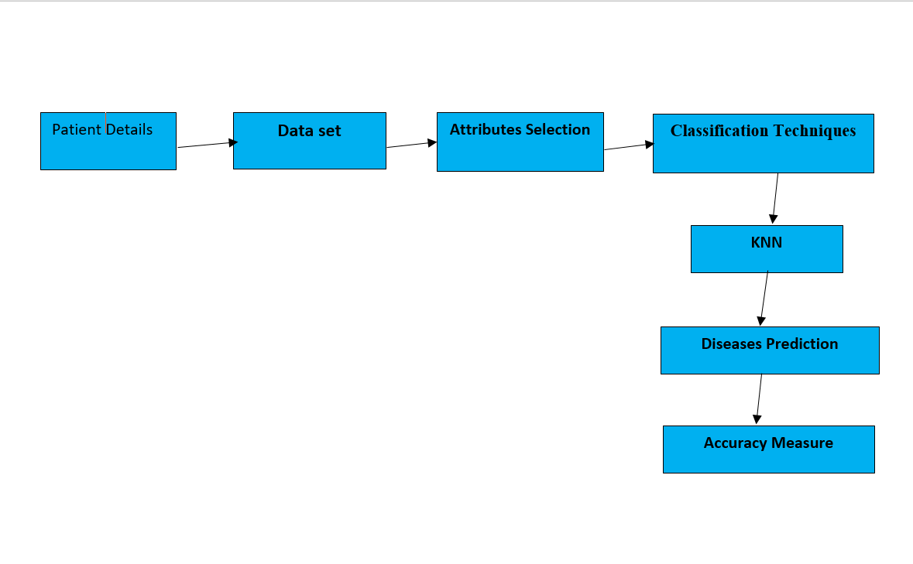
PROBLEM DEFINITION

Slide 14
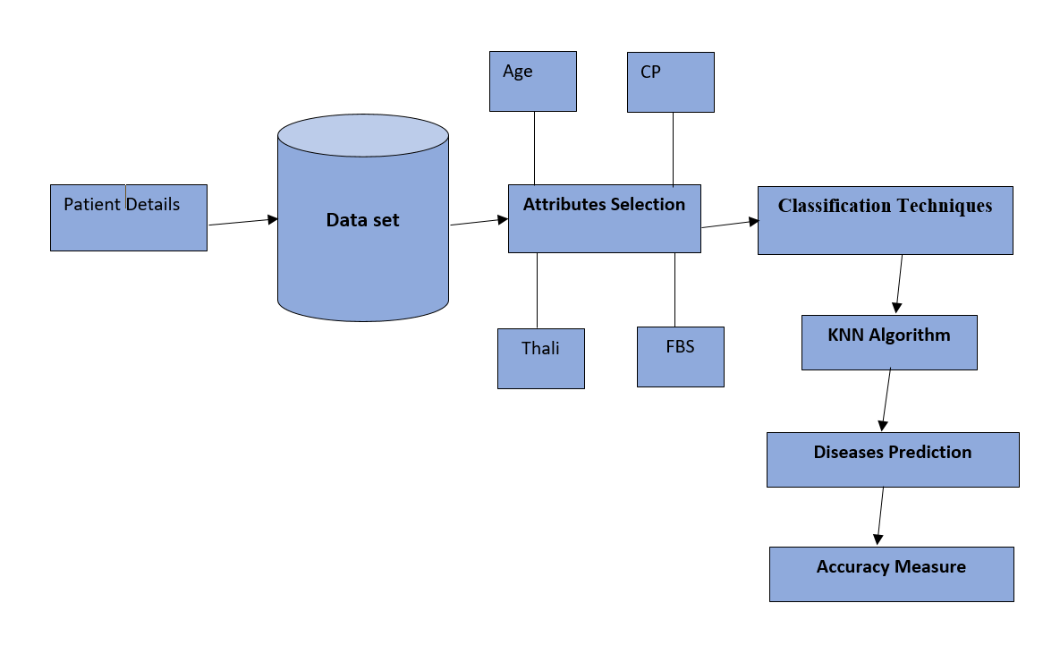
FLOW DIAGRAM

Slide 15
OBJECTIVIES
Early Detection and Diagnosis
Improving Accuracy
Personalized Medicine
Reducing Healthcare Costs
Predictive Analytics

Slide 16
METHODOLOGY
Data Collection
Data Preprocessing
Splitting the Dataset
Building the KNN Model
Model Training
Model Evaluation

Slide 17
IMPLEMENTAION
Step-by-Step Implementation
Import Necessary Libraries
Load the Dataset
Data Preprocessing
Feature Scaling
Splitting the Dataset
Building and Training the KNN Model
Model Evaluation
Final Model Training and Prediction
Save and Load the Model

Slide 18
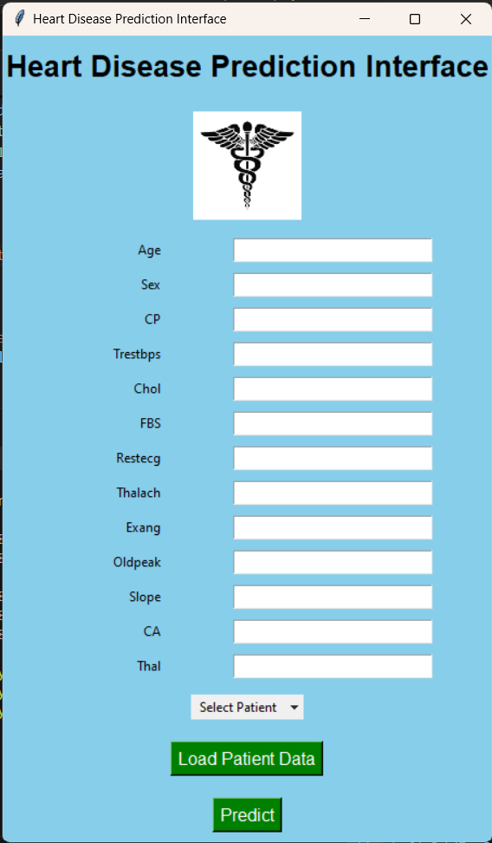
User Interface

Slide 19

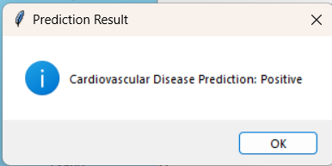

Slide 20

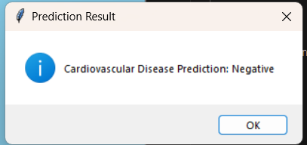

Slide 21
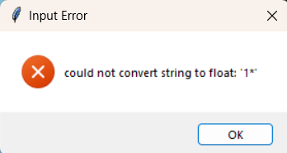
Wrong input in the interface

Slide 22
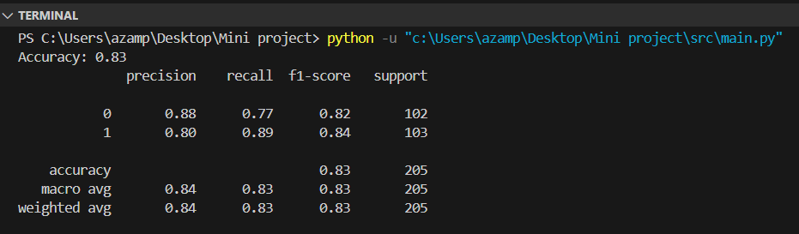
RESULTS

Slide 23
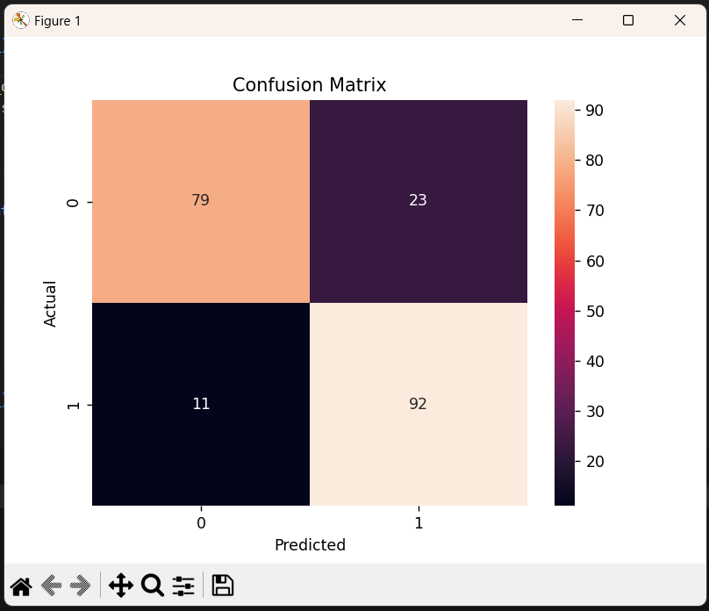
RESULTS

Slide 24
CONCLUSION
Potential of k-NN
83% accuracy achieved
Future algorithm exploration
User-friendly interface

Slide 25
REFERENCES
www.wikipedia.org
2020 International Conference on Electrical and Electronics Engineering (ICE3-2020) IEEE ,Heart Disease Prediction Using Machine Learning Algorithms .
2020 2nd International Conference on Advances in Computing, Communication Control and Networking (ICACCCN).Heart Disease Prediction using Machine Learning Techniques.

Slide 26
THANK YOU

